Slide 1
Weather control

Slide 2
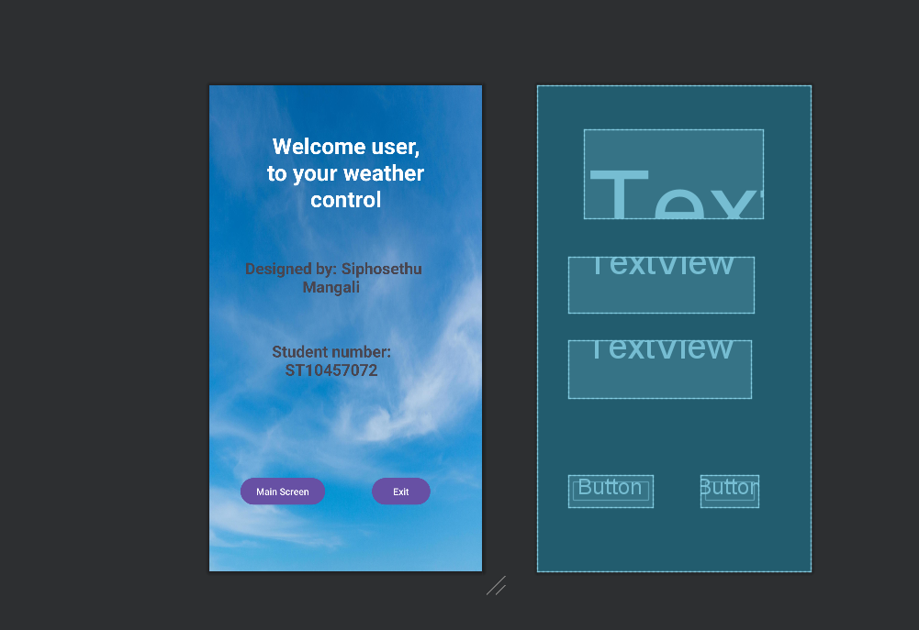
First Page
Once the app is open the user will be notified on who made the program and that individuals student number
There are two options to choose from; first is the go to the main screen where the information of the weather is collected or exit the app

Slide 3
App opening code
package com.example.imadexam import android.content.Intent import android.os.Bundle import android.widget.Button import androidx.appcompat.app.AppCompatActivity import com.example.imad.R class MainActivity : AppCompatActivity() { lateinit var MainScreen: Button override fun onCreate(savedInstanceState: Bundle?) { super.onCreate(savedInstanceState) MainScreen = findViewById<Button>(R.id.mainbtn) MainScreen.setOnClickListener { val intent = Intent(this, MainScreen::class.java) startActivity(intent) } } }
The code that allows the user to move to the second page

Slide 4
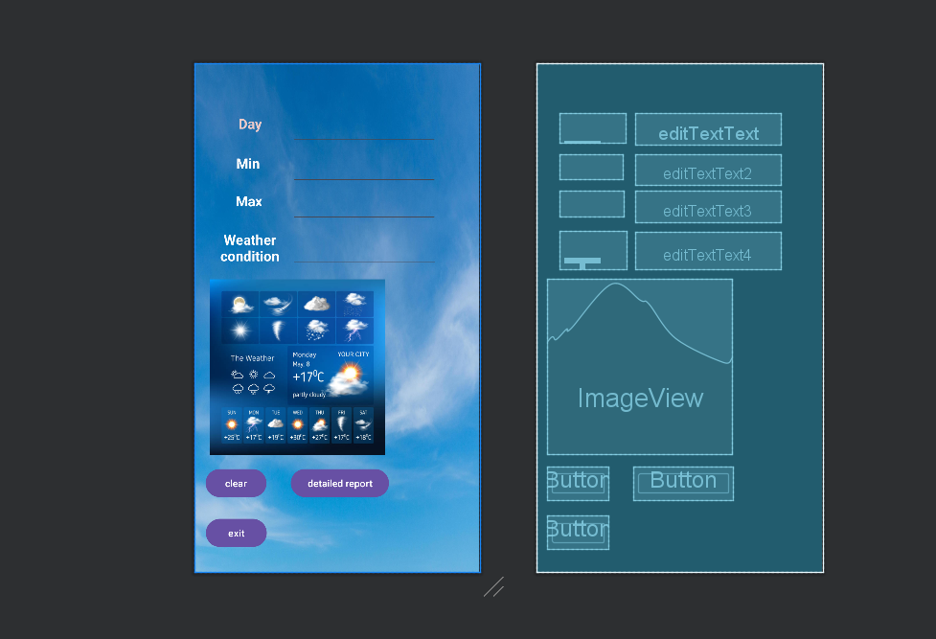
Second Page
Here is where the the information about the weather for days of the week are recorded
There are three options if the user wants to decide from:
The clear button if the information the user gave is incorrect, it can easily be removed
The exit button, to exit the app
The detailed report is where the information the user input will be recorded on a table

Slide 5
Splash screen code
package com.example.imad import android.content.Intent import android.os.Bundle import android.widget.Button import android.widget.TextView import androidx.activity.enableEdgeToEdge import androidx.appcompat.app.AppCompatActivity class mainscreen : AppCompatActivity() { lateinit var report: Button val min = arrayOf<String>("6", "10", "12", "5", "7", "21", "20") val max = arrayOf<String>("8", "14", "18", "10", "9", "19", "15") val condition = arrayOf<String>("cloudy", "cold", "sunny", "rain", "rain", "hot", "sunny") override fun onCreate(savedInstanceState: Bundle?) { super.onCreate(savedInstanceState) enableEdgeToEdge() setContentView(R.layout.activity_mainscreen) // declaring the minimum weather val min1TextView = findViewById<TextView>(R.id.min1) val min2TextView = findViewById<TextView>(R.id.min2) val min3TextView = findViewById<TextView>(R.id.min3) val min4TextView = findViewById<TextView>(R.id.min4) val min5TextView = findViewById<TextView>(R.id.min5) val min6TextView = findViewById<TextView>(R.id.min6) val min7TextView = findViewById<TextView>(R.id.min7) // declaring the maximum weather val max1TextView = findViewById<TextView>(R.id.max1) val max2TextView = findViewById<TextView>(R.id.max2) val max3TextView = findViewById<TextView>(R.id.max3) val max4TextView = findViewById<TextView>(R.id.max4) val max5TextView = findViewById<TextView>(R.id.max5) val max6TextView = findViewById<TextView>(R.id.max6) val max7TextView = findViewById<TextView>(R.id.max7) // declaring the condition of the weather val condition1TextView = findViewById<TextView>(R.id.condition1) val condition2TextView = findViewById<TextView>(R.id.condition2) val condition3TextView = findViewById<TextView>(R.id.condition3) val condition4TextView = findViewById<TextView>(R.id.condition4) val condition5TextView = findViewById<TextView>(R.id.condition5) val condition6TextView = findViewById<TextView>(R.id.condition6) val condition7TextView = findViewById<TextView>(R.id.condition7) // setting minimum weather into the textview min1TextView.text = min[0] min2TextView.text = min[1] min3TextView.text = min[2] min4TextView.text = min[3] min5TextView.text = min[4] min6TextView.text = min[5] min7TextView.text = min[6] // setting maximum weather into the textview max1TextView.text = max[0] max2TextView.text = max[1] max3TextView.text = max[2] max4TextView.text = max[3] max5TextView.text = max[4] max6TextView.text = max[5] max7TextView.text = max[6] // setting the weather conditions into the textview condition1TextView.text = condition[0] condition2TextView.text = condition[1] condition3TextView.text = condition[2] condition4TextView.text = condition[3] condition5TextView.text = condition[4] condition6TextView.text = condition[5] condition7TextView.text = condition[6] val ReportActivity = findViewById<Button>(R.id.detailbtn) ReportActivity.setOnClickListener { val intent = Intent(this, ReportActivity::class.java) startActivity(intent) } } }
This is the code that records the days weather that was implemented into the code

Slide 6
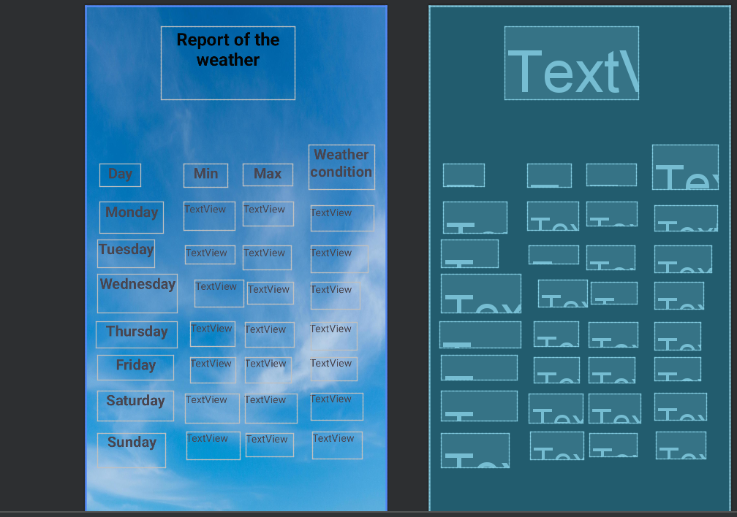
Third page
Here is where all the information the user input and then it was recorded lies so it can be on an easy to read format

Slide 7
Result code
package com.example.imad import android.os.Bundle import androidx.activity.enableEdgeToEdge import androidx.appcompat.app.AppCompatActivity import androidx.core.view.ViewCompat import androidx.core.view.WindowInsetsCompat class report : AppCompatActivity() { override fun onCreate(savedInstanceState: Bundle?) { super.onCreate(savedInstanceState) enableEdgeToEdge() setContentView(R.layout.activity_report) ViewCompat.setOnApplyWindowInsetsListener(findViewById(R.id.main)) { v, insets -> val systemBars = insets.getInsets(WindowInsetsCompat.Type.systemBars()) v.setPadding(systemBars.left, systemBars.top, systemBars.right, systemBars.bottom) insets } } }
This is where the information is implemented and is placed

